Slide 1
FRUIT SORTER
PROJECT GUIDE:-
PROF. SREEMATHY
Roll No. | Name of the Student |  |  | e-mail id |  | Mobile No.
3603 | Rishabh Agarwal |  |  | rishabh5530@gmail.com |  | 9096074621
3606 | Titiksha Arora |  |  | titiksha31@gmail.com |  | 8796219255
3619 | Ankita Chinnawar |  |  | ankita.c.550@gmail.com |  | 9422346541

Slide 2
INTRODUCTION :-
•Fruit commercialization is the main purpose of its sorting.
• Fruit in the same tree differ in quality such as feature, flavour because their growth was affected by many environmental factors. Especially, fruit from different orchards differ significantly in size and quality.
•Sorting may not only standardize fruit product but also promote management of the fruit tree in orchard and product quality. Fruits and vegetables are very difficult to grade and sort exactly and rapidly because of their significant difference in feature such as size, shape and color as a result of changeable conditions of nature environment and manual factors.
•Manual sorting is lack of objectivity, accuracy and has lower efficiency because there is individual difference in visual inspecting which is affected by human healthy condition, psychological condition, lightness, fatigue and so on. But levels of mechanical and automatic grading of fruit and vegetable go higher and higher with the enhancement of mechanization, automatization and application of computer technology.

Slide 3
PROBLEM DEFINITION :-
Design of a system for the analysis of the fruit and classification based on color and grading as well as sorting these fruits in different categories for the commercial purposes.

Slide 4
LITERATURE SURVEY
Machine vision based automatic fruit grading system using fuzzy algorithm.
An automated machine vision based system for fruit sorting and grading
Thresholding-based segmentation and apple grading by machine vision

Slide 5
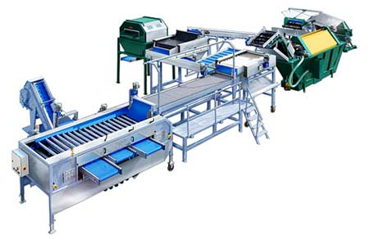
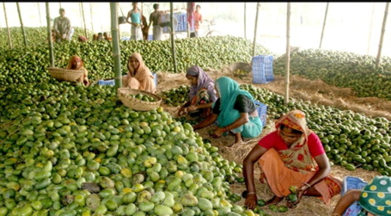
MOTIVATION:-
Time Consuming
Expensive
Low Efficiency
Low Cost
High Speed
Improved Efficiency

Slide 6
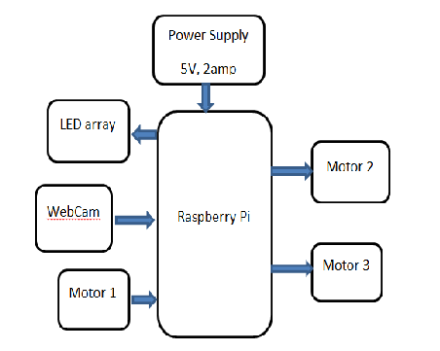
BLOCK DIAGRAM:-

Slide 7
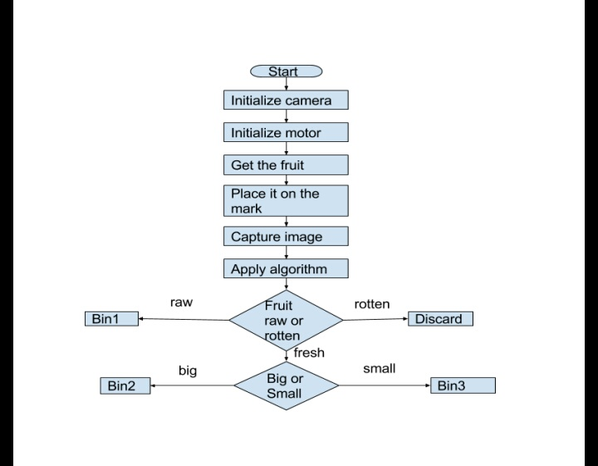
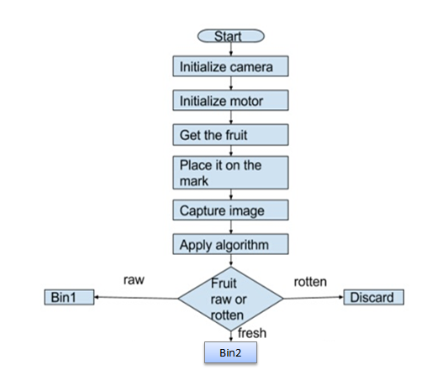
FLOW CHART:-

Slide 8
Hardware and Software
Hardware Requirements:
Raspberry pi
Web Camera
LED array
Mechanical setup including 3 Servo motors with Plywood base
Power Supply
Software Requirements:
Windows 10/Ubuntu/Raspbian
Python
OpenCV
Sklearn

Slide 9
PROCESS:-
Image grabbing or acquiring
Image preprocessing
Segmentation of image
Representation of image and feature extraction
Image recognition and analysis using SVM classifier
Putting the fruit in the respective bins according to the ripeness as classified by the classifier.

Slide 10
FUTURE SCOPE
Fruit Recognition
Machine Learning
Increasing the Data Set
Using Neural Networks

Slide 11
RESULT:-
Tested our system for 55 lemons in which 30 were Yellow, 15 were Green and 10 were Brown
Out of 55, 33 were sorted correctly from yellow there were 19, from green there were 9 and from brown there were 5.
Hence the accuracy of the system is 60%.

Slide 12
STATISTCS:-
TABLE
 | TOTAL | CORRECTLY CLASSIFIED
YELLOW | 30 | 19
GREEN | 15 | 9
BROWN | 10 | 5

Slide 13
CHART:-

Slide 14
CONCLUSION:-
We have successfully built a product which has a WebCamera on top of it to capture the images and a raspberry pi to process the image.
We learnt the basics of OpenCV and Image Processing and implemented the detection of quality of fruit on the basis of ripeness.
We learnt the basics of Machine learning and learnt how to classify images using SVM.
We have also learnt the Data training of objects, here want to recognize the quality of lemon with an efficiency of 60-70 % efficiency.
We learnt the Interfacing of Raspberry Pi with Webcam and Motors and Leds, and basics of python were one of the prerequisites of the project.

Slide 15
REFERENCES:-
Ming Liang, Xiaolin Hu., “Computer Vision and Pattern Recognition (CVPR)” , Recurrent Convolutional Neural Network for Object Recognition IEEE Conference Boston, pp. 3367-3375, 2015..
Ajay Pal Singh Chauhan & Amar Partap Singh,” Virtual Grader for Apple Quality Assessment using Fruit Size and Illumination Features “, Year Global Journal of Computer Science and Technology ( DGD ) Volume XIV Issue IV Version I 2014, February 2014 DOI: 10.1109/CIEC.2014.6959043.

Slide 16
THANK YOU!!

